Slide 1


Movie Recommendation DSC 680 – Project 1 Rohan Valder

Slide 2
Presentation Overview
Project Details
Methods Used
Data Visualization
Graphs of the training and test data
Results
References

Slide 3
Project Details
Dataset Link:
https://www.kaggle.com/ibtesama/getting-started-with-a-movie-recommendation-system/data
Dataset Information:
The dataset consists of moviesreleased on or before July 2017. Data points include cast,
crew, production companies, budget, revenue, languages, countries, TMDB votes, vote averages, plot keywords, posters, and release dates. The dataset contains file with 26 million ratings from 270,000
users for the 45,000 movies. Ratings are on a scale of 1 to 5.

Slide 4
Meth ods Used
This project will be using the collaborative filtering to build the movie recommender system.
This project will be using the collaborating filtering
Collaborative filtering has two senses:
- A narrow sense
- A general sense

Slide 5
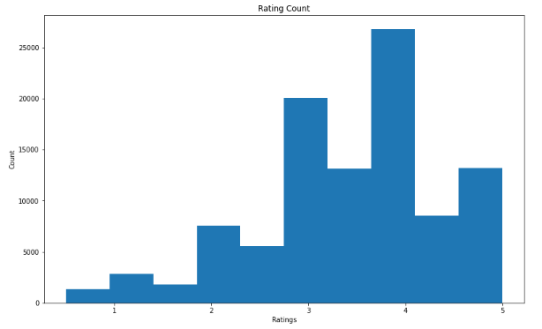
Data Visualization – Examine the rating counts
This project will be using the collaborative filtering to build the movie recommender system.

Slide 6
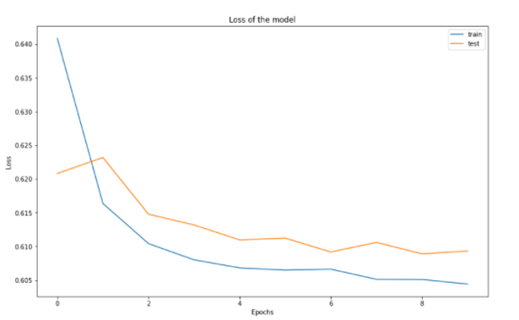
The graphs of the training and test data after fitting
This project will be using the collaborative filtering to build the movie recommender system.

Slide 7
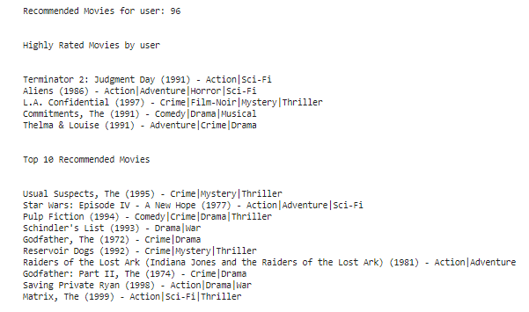
Ten recommended movies for a random user
This project will be using the collaborative filtering to build the movie recommender system.

Slide 8
References:
Nurdialit, Dwi Gustin (2020, September). Netflix Movies and TV Shows — Exploratory Data Analysis (EDA) and Visualization Using Python. - https://medium.com/analytics-vidhya/netflix-movies-and-tvshows-exploratory-data-analysis-eda-and-visualization-using-python-80753fcfcf7
Pradhan, Karan (2021, July). Visualizing Netflix Data Using Python! - https://www.analyticsvidhya.com/blog/2021/07/visualizing-netflix-data-using-python/
Ramos, Leodanis Pozo (2022, Feb). Python's zipfile: Manipulate Your ZIP Files Efficiently - https://realpython.com/python-zipfile/
Ebrahim, Mokhtar (2022, Feb). Python time module (Simple Examples) - https://likegeeks.com/python-time-module/

